Slide 1
Q
u
e
u
e
Made by : EMAM

Slide 2


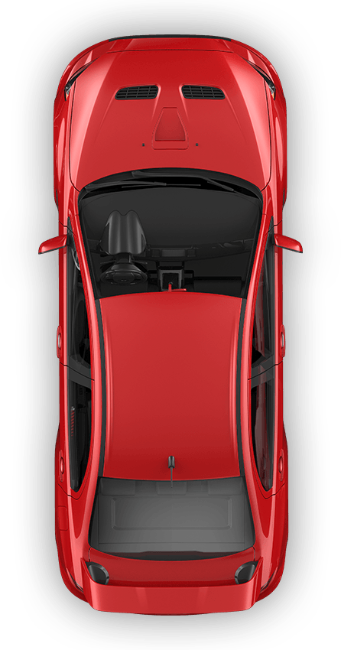
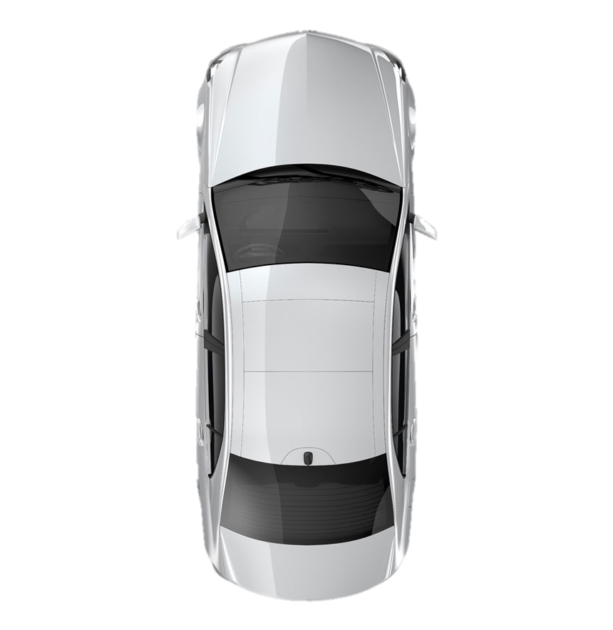
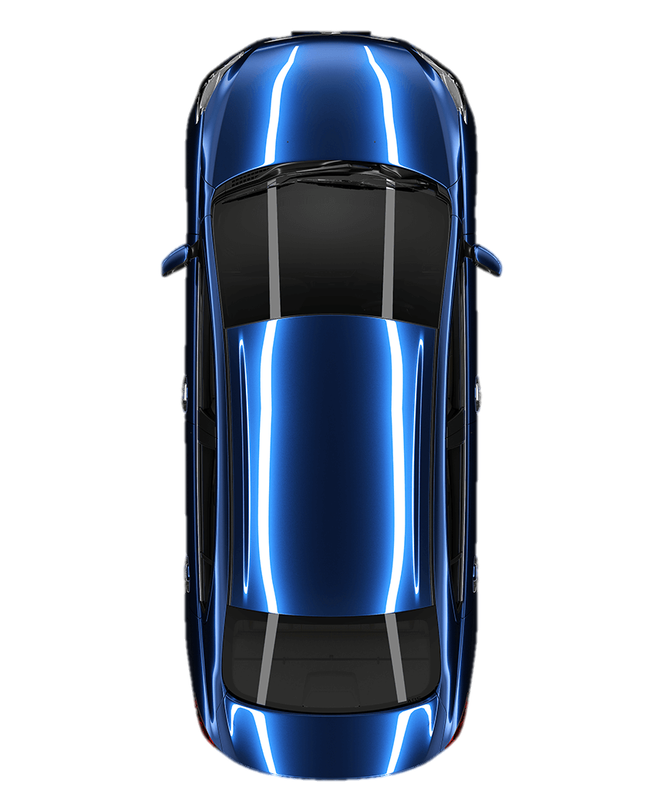
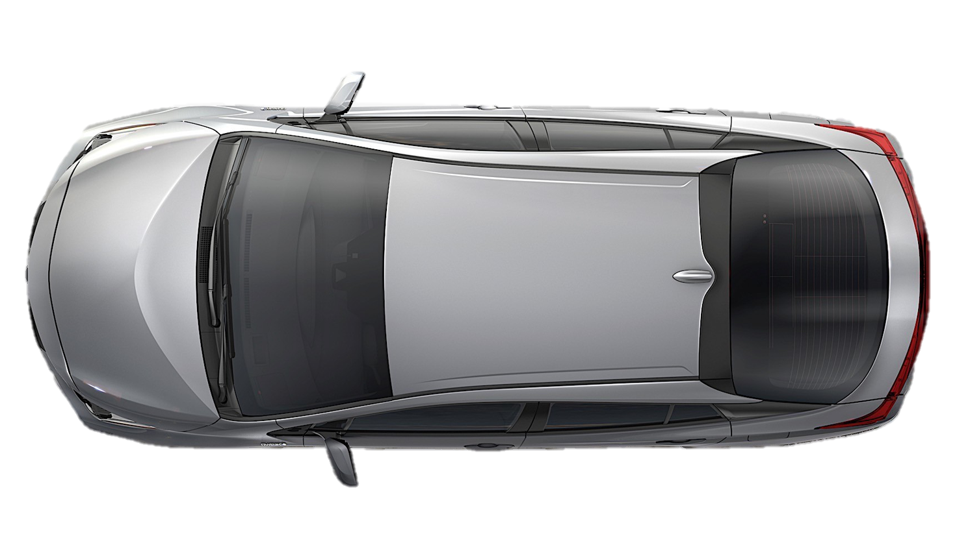
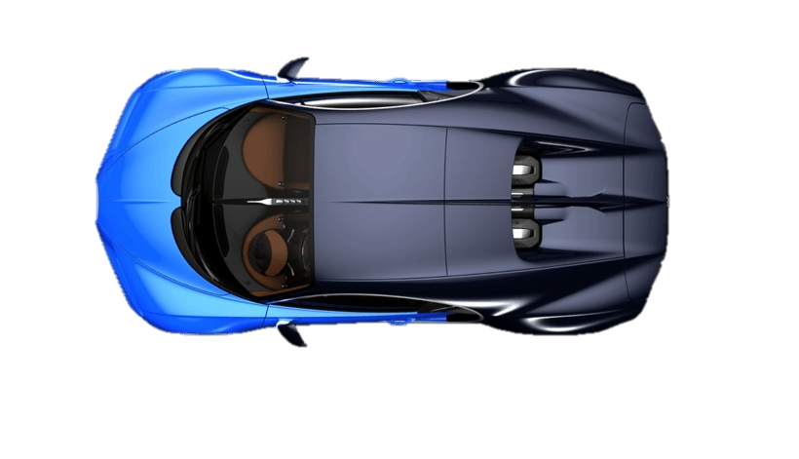
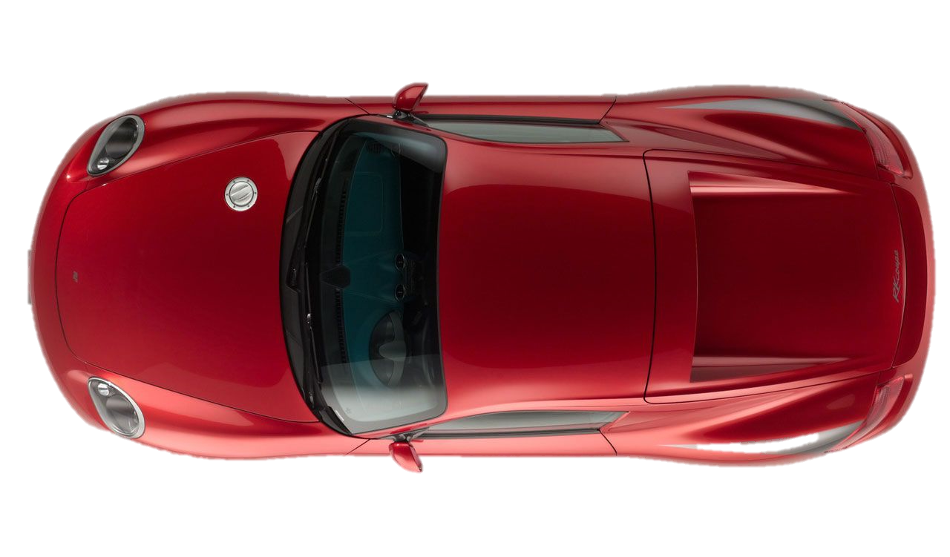
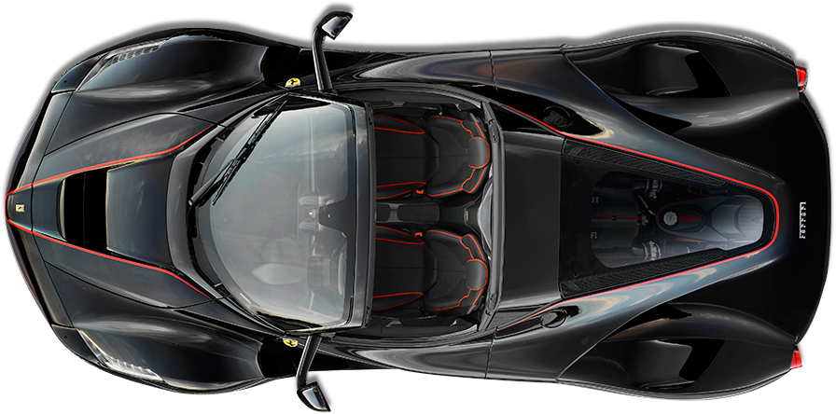
4
3
2
1
Made by : EMAM

Slide 3
front
0
1
2
3
4
5
E
M
A
M
rear
⁠👍⁠
enqueue ()
dequeue ()
Made by : EMAM

